Slide 1
Pennsylvania Prison Chaplains Association
Pennsylvania Prison Chaplains Association
2019 Annual Conference
The Intersections of Chaplaincy and Mental Health:
Suicide Prevention within an Incarcerated Setting
Dr. Lucas D. Malishchak, DBA
Director of the Psychology Office
Pennsylvania Department of Corrections

Slide 2
Suicide in Jails and Prisons
Jails | 50 per 100,000
Prisons | 20 per 100,000
Community | 12 per 100,000
5th leading cause of death in prisons, after:
(1) Heart disease, (2) Cancer, (3) Liver disease, (4) AIDS

Slide 3
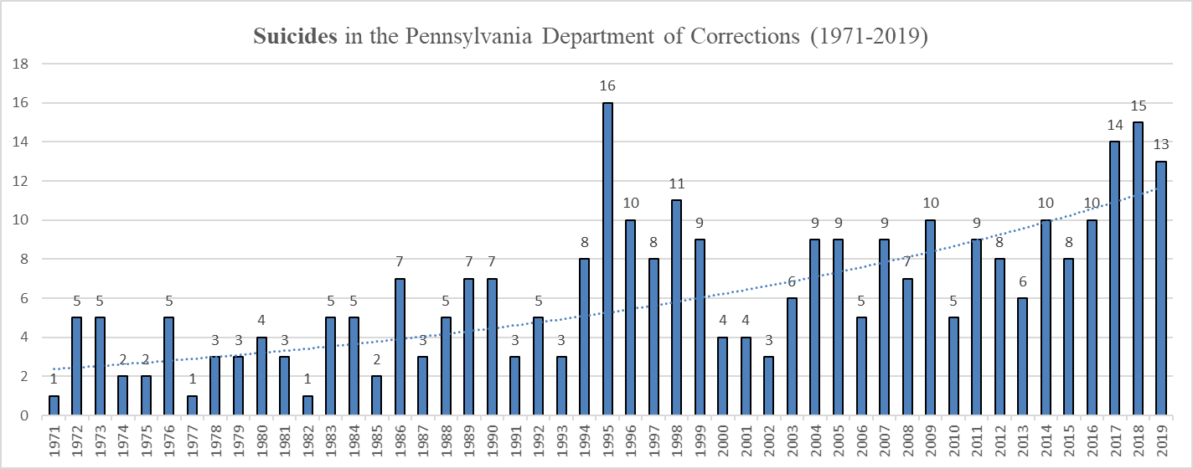
PA DOC Suicides
Notes:
This slide is intended to provide a snapshot for staff on the number of suicides that have occurred in our system during the past 50 years.
Discussion topic: what do we see in the trend line? What are the possible explanations for this gradual increase?
Potential explanations of recent rise: Our number of individuals on the Mental Health roster increased by 93% (almost doubled) from 2006 to 2018. The latest national report on prison suicides is published by the DOJ’s Bureau of Justice Statistics (BJS) and only goes through 2014. There is no reliable source of data after 2014, and no reliable source of data comparing suicide attempts in prisons across the nation. According to the BJS report, the suicide death rate in prisons increased nationally by 25% between 2007 and 2014. In PA during the same time, our suicide death rate only increased by 13%, so below the national average increase. Also from the BJS report, the overall annual average suicide rate per 100,000 inmates nationally is 16 per 100,000 inmates. Pennsylvania is far from the highest state, and is right at the average at 16 suicides per 100,000 inmates. Suicides have increased among the general population in Pennsylvania. Reports have shown that suicides in PA have increased by more than 30% since 1999. In that sense, DOC inmates are a microcosm of what is happening among the general population.

Slide 4
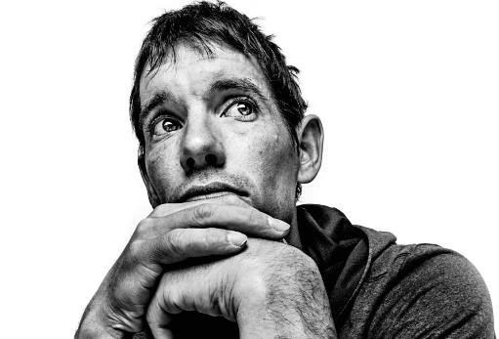
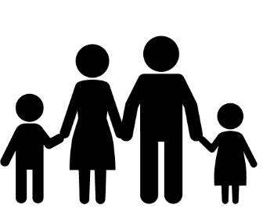
Suicides in Correctional Settings
What is it about the process of incarceration that may help explain why suicide rates are much higher amongst those incarcerated than compared to those in the community?
Notes:
Potential Answers:
1.) Detachment from family and loved ones
2.) Increased opportunities of being alone, due to presentation of institutional risk
3.) Fear of the unknown
4.) Distrust of authoritarian environment
5.) Shame of incarceration
6.) Dehumanizing aspects of incarceration
The process of incarceration may present a life-crisis for the individual. It is quite possible that following a binge of excessive drinking or drug use, the individual was arrested, placed in county jail, and now all of a sudden has been sentenced to state prison as a result of a wild weekend with some friends.
Such a crisis or change presents a serious loss of stabilizing resources for the individual and potential dependent’s of the individual (e.g., a father who was the main source of income for a family of three children and a disabled wife).
Obviously, the process of incarceration removes an individual from the community and away from friends and family, creating a feeling of isolation from one’s social or support network.
Additionally, incarceration can provoke feelings of shame surrounding the offense and or other’s known to the individual in the community.
Incarceration presents a crisis for the individual
Hayes, L.M. (1999). Suicide in adult correctional facilities: Key ingredients to prevention and overcoming the obstacles. The Journal of Law, Medicine, & Ethics, 27(3), 260-268. DOI:10.1111/j.1748-720X.1999.tb01460.x

Slide 5
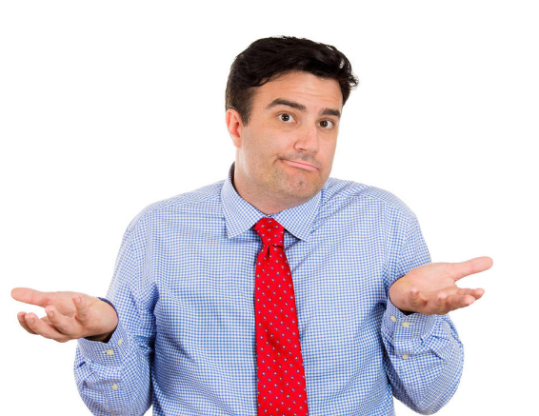
Attitudes about Suicide
Examples of negative attitudes?
Potential impact of negative staff attitudes about suicide?
Notes:
Potential impact of negative attitudes towards suicide: How we think (i.e., our attitudes), influences how we act. In this regard, the potential impact of negative staff attitudes (e.g., if someone wants to die by suicide, there is nothing we can do to prevent it) towards suicide is immense. If our perspective is that we can’t prevent suicides, we are less likely to be successful in achieving our goal of preventing and eliminating suicides. Negative attitudes about suicides can also lead to complacency in completing our daily tasks (e.g., security rounds, mental health contacts, etc.). Negative attitudes about suicides can lead to our correctional settings being less safe. If your attitude is that preventing suicides is the responsibility of just medical staff or just correctional officers, you will NOT take ownership of this responsibility. It is imperative that all staff take ownership of preventing suicides within the Pennsylvania Department of Corrections.
Examples of negative attitudes:
1.)“we did everything we could to prevent this death, but he showed no signs of suicidal behavior”.
2.) “There’s no way you can prevent suicides unless you have someone sitting watching the individual all the time, an no one can afford to be a baby sitter.”
3.) “We didn’t consider him suicidal, he was simply being manipulative and I guess it just went too far.”
4.) “If someone really wants to kill themselves, there’s generally nothing you can do about it.”
5.) “Suicide prevention is a medical problem….its a mental health problem….it’s not our problem.”
Hayes, L.M. (1999). Suicide in adult correctional facilities: Key ingredients to prevention and overcoming the obstacles. The Journal of Law, Medicine, & Ethics, 27(3), 260-268. DOI:10.1111/j.1748-720X.1999.tb01460.x

Slide 6
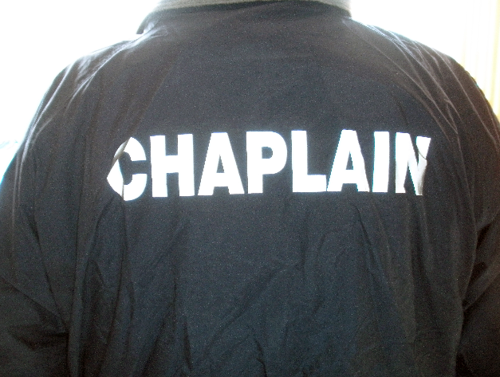
Attitudes about Suicide
Administration and Front Line Staff Attitudes about Suicide
Our Expectation: ALL SUICIDES CAN BE PREVENTED
“ NEGATIVE STAFF ATTITUDES IMPEDE SUICIDE PREVENTION EFFORTS”
Notes:
Administration and Front Line Staff Attitudes about Suicide
Our expectation: It is imperative that all staff consider the impact of one’s attitude toward suicides. As leaders in the field of corrections, it is essential that PADOC staff embody the perspective that ALL SUICIDES CAN BE PREVENTED. In this regard, our agency’s perspective and goal is to eliminate and prevent all suicides. It is essential that all staff take the perspective and personify the attitude of achieving the goal of 0 suicides. Although it may sound minor, one’s attitude can significantly impact one’s performance in pursuing such a goal. Embracing the right attitude about suicide prevention is the foundation of eliminating suicides in our system.
The take away message about ALL staffs’ attitudes about suicide is that NEGATIVE STAFF ATTITUDES IMPEDE SUICIDE PREVENTION EFFORTS.
Hayes, L.M. (1999). Suicide in adult correctional facilities: Key ingredients to prevention and overcoming the obstacles. The Journal of Law, Medicine, & Ethics, 27(3), 260-268. DOI:10.1111/j.1748-720X.1999.tb01460.x

Slide 7
Attitudes about Suicide
How do we implement the “right attitude” about suicides?
  1.) Take all threats seriously.
  2.) Those incarcerated are vulnerable.
  3.) Treat those incarcerated fairly and humanely.
  4.) Understand the seriousness of your role and responsibilities.
  5.) Be professional, at all times.
  6.) View suicide as EVERYONE’S responsibility.
  7.) Believe that all suicides can be prevented.
Notes:
Some examples of how to epitomize or exemplify this attitude: 1. Take all suicide threats seriously; 2. View those incarcerated as a vulnerable population and generally at higher risk of suicide than those in the community; 3. Treating those incarcerated fairly and humanely, at all times; 4. Understand the seriousness of your roles and responsibilities as a correctional professional, with regard to ensuring the care, custody, and control of those individuals confined. 5. Conduct yourself professionally, at all times; 6. Viewing suicide prevention as EVERYONE’S responsibility (i.e., ALL DOC staff). 7. Understand that together, as a team, we can prevent all suicides.

Slide 8
Communication and Collaboration
To help eliminate suicides, there are three main stages of communicating concerning information pertaining to increased risk of suicide amongst incarcerated individuals:
1.) Communication between transporting officer and correctional staff
2.) Communication among all facility staff
3.) Communication between facility staff and the at risk individual
Notes:
Suicide prevention really begins well before an individual enters our custody in the department of corrections. In this regard, it is essential that any concerning information known by sending facilities or entities, be shared with the receiving facility or entity. One may ask, well, I guess there isn’t anything for us to do when we receive someone into our custody, because it is the sending entity’s responsibility to share relevant information. However, our attitude must be different. Here, our responsibility is to inquire whether or not there is any concerning information related to suicide risk from the sending entity and or whether there are any relevant records that should be shared so that we are completely aware of all existing information and risk factors related to suicide. This concept of information sharing also applies to intrasystem transfers (i.e., those transfers that occur within our system from one SCI to another SCI). Here, transporting officers must be observant and vigilant for any behavioral signs indicative of increased risk of suicide (e.g., transfers due to separation or serious assault). Sharing all relevant information is critical to our success as an integrated system.
Communication within a facility is easier said that done. Despite the perspective that we are all on the same team, and focused on the same mission, communicating across disciplines does not always occur smoothly. There are shift changes, rotating officers, new hires, a constant influx of new inmates, personality differences, outdated views of corrections (e.g., treatment vs. security), rising case loads, unexpected staff illnesses, etc. Two of the critical features of our system that help mitigate this barrier to effective communication amongst disciplines are the Unit Management team approach and the Psychiatric Review Team. These teams are comprised of multiple disciplines (i.e., both of which include security staff) aimed at facilitating communication between and amongst those individuals charged with the care, custody, and control of those incarcerated in our system.
Finally, and probably most importantly, it is essential that staff utilize active listening skills and other known effective ways of communicating with those individuals that are at increased risk for suicide. Ensuring that regular and ongoing communication between the staff member and the individual is key to monitoring the individual’s ever changing level of risk.
Hayes, L.M. (1999). Suicide in adult correctional facilities: Key ingredients to prevention and overcoming the obstacles. The Journal of Law, Medicine, & Ethics, 27(3), 260-268. DOI:10.1111/j.1748-720X.1999.tb01460.x

Slide 9
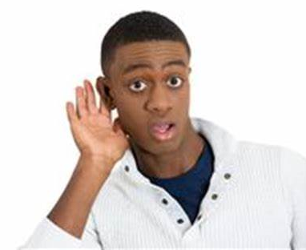
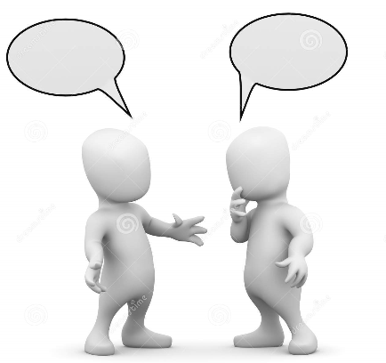
Communication and Collaboration
Communication between staff and the potentially suicidal individual REQUIRES a
Private and Confidential Setting
Notes:
An additional area of communication that requires further detail is the communication between mental health staff and the potentially suicidal individual.
The main component of ensuring we are giving our mental health professionals the best opportunity to mine relevant and sensitive information from potentially suicidal inmates is affording interview settings that are PRIVATE AND CONFIDENTIAL FROM BOTH OTHER INMATES AND NON-HEALTH CARE PERSONNEL). Indeed, these conversations and assessments are high stakes decisions that require such a setting to be successful. A private and confidential setting affords the vulnerable individual an opportunity to meet directly with mental health treatment staff in a setting that is conducive to sharing potentially sensitive information. This approach gives our department, our treatment providers, and the individuals in our care, the best opportunity to collaboratively problem solve and discuss issues related to suicidality and safety.
Affording a private and confidential setting for such a contact is based on the individual’s behavioral compliance. For example, if the individual is threatening to injure officers or is actively throwing substances out of her cell at the time and refusing to come out of her cell to meet with the mental health professional (i.e., in which the mental health professional desires to have an out of cell private and confidential contact with the individual to assess for suicidality), it may not be able to be accommodated based on the threat and danger posed by the individual.
If the individual cannot be safely brought out of their cell, according to the collaborative discussion with security and treatment staff, the individual will not be brought out at that time.
Although staff safety is paramount, we should not inadvertently compromise reasonable privacy and confidentiality.

Slide 10
“False Deniers”
Communication between staff and the potentially suicidal individual can be difficult. One example of how this process can be difficult is seen with false deniers.
*SCENARIO*
Notes:
Scenario:
Upon finishing your service on Sunday morning, inmate Roberts approaches you in the vestibule of the Chapel. You ask Roberts if everything is ok and Roberts responded that he found out late last week that his grandmother passed away. In speaking to Roberts, you notice that he is somewhat sad, but indicates that his grandmother was almost 80 years old, so her passing was expected. As the conversation continues, you realize that you haven’t seen Mr. Roberts at service in the past several weeks, which is unusual for him as he is quite committed to his faith. Also, given your collaboration with other disciplines in the prison and your familiarity with Mr. Roberts’ life, you realize that he also hasn’t been to work in the Employee Dining Hall for the past few days. Upon recalling these factors, you ask to speak to Mr. Roberts in the privacy of your office. During the conversation in your office, Mr. Roberts indicates that he is expected to be paroled in the next few months, but was uncertain about his living situation in the community because of his grandmother’s passing. As the conversation progresses, you ask Mr. Roberts if he is having any thoughts about hurting or killing himself. Mr. Roberts states that, really, he is fine and he would never hurt himself because he has older kids that live in the Carolinas.
What do you do?
Refer to Psychology staff for an assessment. It appears quite possible that inmate Roberts is a “false denier” and may actually be having suicidal thoughts or plans despite stating the contrary to the Chaplain.
The take home message is that we can’t simply rely upon how individuals respond to our direct questions about whether or not they are having suicidal thoughts or plans. Yes, it is vitally important that you ask the question of whether or not the individual is contemplating suicide. Yes, it is extremely important to inquire about issues that appear concerning to you. However, some times, individuals are not completely forthcoming about these thoughts and feelings. As a result, in order to more accurately identify individuals who are at increased risk of suicide, we need to be cognizant of other existing risk factors and protective factors associated with a suicide risk assessment.

Slide 11
“False Deniers”
Upon finishing your service on Sunday morning, inmate Roberts approaches you in the vestibule of the Chapel. You ask Roberts if everything is ok and Roberts responded that he found out late last week that his grandmother passed away. In speaking to Roberts, you notice that he is somewhat sad, but indicates that his grandmother was almost 80 years old, so her passing was expected. As the conversation continues, you realize that you haven’t seen Mr. Roberts at service in the past several weeks, which is unusual for him as he is quite committed to his faith. Also, given your collaboration with other disciplines in the prison and your familiarity with Mr. Roberts’ life, you realize that he also hasn’t been to work in the Employee Dining Hall for the past few days. Upon recalling these factors, you ask to speak to Mr. Roberts in the privacy of your office. During the conversation in your office, Mr. Roberts indicates that he is expected to be paroled in the next few months, but was uncertain about his living situation in the community because of his grandmother’s passing. As the conversation progresses, you ask Mr. Roberts if he is having any thoughts about hurting or killing himself. Mr. Roberts states that, really, he is fine and he would never hurt himself because he has older kids that live in the Carolinas.
Notes:
Scenario:
Upon finishing your service on Sunday morning, inmate Roberts approaches you in the vestibule of the Chapel. You ask Roberts if everything is ok and Roberts responded that he found out late last week that his grandmother passed away. In speaking to Roberts, you notice that he is somewhat sad, but indicates that his grandmother was almost 80 years old, so her passing was expected. As the conversation continues, you realize that you haven’t seen Mr. Roberts at service in the past several weeks, which is unusual for him as he is quite committed to his faith. Also, given your collaboration with other disciplines in the prison and your familiarity with Mr. Roberts’ life, you realize that he also hasn’t been to work in the Employee Dining Hall for the past few days. Upon recalling these factors, you ask to speak to Mr. Roberts in the privacy of your office. During the conversation in your office, Mr. Roberts indicates that he is expected to be paroled in the next few months, but was uncertain about his living situation in the community because of his grandmother’s passing. As the conversation progresses, you ask Mr. Roberts if he is having any thoughts about hurting or killing himself. Mr. Roberts states that, really, he is fine and he would never hurt himself because he has older kids that live in the Carolinas.
What do you do?
Refer to Psychology staff for an assessment. It appears quite possible that inmate Roberts is a “false denier” and may actually be having suicidal thoughts or plans despite stating the contrary to the Chaplain.
The take home message is that we can’t simply rely upon how individuals respond to our direct questions about whether or not they are having suicidal thoughts or plans. Yes, it is vitally important that you ask the question of whether or not the individual is contemplating suicide. Yes, it is extremely important to inquire about issues that appear concerning to you. However, some times, individuals are not completely forthcoming about these thoughts and feelings. As a result, in order to more accurately identify individuals who are at increased risk of suicide, we need to be cognizant of other existing risk factors and protective factors associated with a suicide risk assessment.

Slide 12
“False Deniers”
What do you do?
Refer to Psychology staff for an assessment. It appears quite possible that inmate Roberts is a “false denier” and may actually be having suicidal thoughts or plans despite stating the contrary to the Chaplain.
The take home message: there is more to risk assessment than simply relying on the individual’s input.
Notes:
Scenario:
Upon finishing your service on Sunday morning, inmate Roberts approaches you in the vestibule of the Chapel. You ask Roberts if everything is ok and Roberts responded that he found out late last week that his grandmother passed away. In speaking to Roberts, you notice that he is somewhat sad, but indicates that his grandmother was almost 80 years old, so her passing was expected. As the conversation continues, you realize that you haven’t seen Mr. Roberts at service in the past several weeks, which is unusual for him as he is quite committed to his faith. Also, given your collaboration with other disciplines in the prison and your familiarity with Mr. Roberts’ life, you realize that he also hasn’t been to work in the Employee Dining Hall for the past few days. Upon recalling these factors, you ask to speak to Mr. Roberts in the privacy of your office. During the conversation in your office, Mr. Roberts indicates that he is expected to be paroled in the next few months, but was uncertain about his living situation in the community because of his grandmother’s passing. As the conversation progresses, you ask Mr. Roberts if he is having any thoughts about hurting or killing himself. Mr. Roberts states that, really, he is fine and he would never hurt himself because he has older kids that live in the Carolinas.
What do you do?
Refer to Psychology staff for an assessment. It appears quite possible that inmate Roberts is a “false denier” and may actually be having suicidal thoughts or plans despite stating the contrary to the Chaplain.
The take home message is that we can’t simply rely upon how individuals respond to our direct questions about whether or not they are having suicidal thoughts or plans. Yes, it is vitally important that you ask the question of whether or not the individual is contemplating suicide. Yes, it is extremely important to inquire about issues that appear concerning to you. However, some times, individuals are not completely forthcoming about these thoughts and feelings. As a result, in order to more accurately identify individuals who are at increased risk of suicide, we need to be cognizant of other existing risk factors and protective factors associated with a suicide risk assessment.

Slide 13
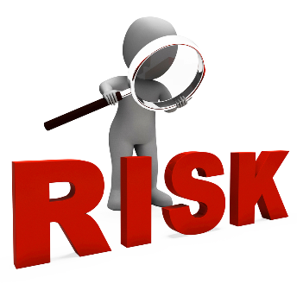
How do CHAPLAINS Assess for Suicide Risk?
Notes:
The purpose of considering an individual’s risk of suicide is not to predict suicidal or self-injurious behavior, but to prevent this behavior through early identification and intervention. Monitoring for elevated risk to engage in any form of self-injury should be considered at all times, when interacting with incarcerated individuals.

Slide 14
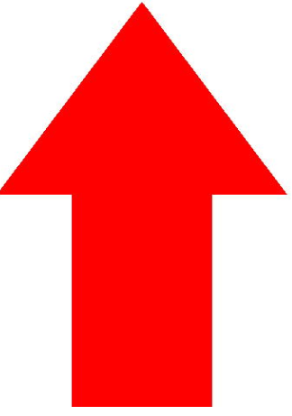
Chronic Risk Factors (historic and demographic) that increase Suicide Risk
Chronic Risk Factors (historic and demographic)
include but not limited to:
Family History of Suicide History of poor impulse control
History of emotional, physical, or sexual abuse Perception of loss of social support
History of major depressive disorder First prison term
History of psychotic disorder Long or Life sentence
Chronic pain problem Sex Offender
Chronic medical illness Caucasian/White Ethnicity
History of substance abuse Older than 35 years of age
History of violence (including index offense) Male
History of Suicide Attempts
Notes:
Chronic Risk Factors are unlikely to change, unless new information is received. Chronic factors relate to events that occurred in an individuals life or that are static (i.e., unchangeable). For example, once an individual has a history of suicide attempts, they will always have a history of suicide attempts. If an individual has a history of being a victim of sexual abuse, they will always have that history.
Can you think of any other chronic risk factors of suicide?

Slide 15
Acute Risk Factors (Within 3 Months) that increase Suicide Risk
Acute Risk Factors (Within 3 Months)
include but not limited to:
Suicidal Ideation (including passive ideation) Early in Prison term
Recent serious suicide attempt Recent change in housing (e.g., RHU)
Current/recent depressive episode Safety Concerns (e.g., gang dropout)
Current/recent psychotic symptoms Agitated or angry
Current/recent anxiety or panic symptoms Disturbance of mood/lability
current/recent substance abuse/intoxication Recent negative staff interactions
Hopelessness/helplessness Evidence of medication hoarding
Increasing interpersonal isolation Recent misconduct
Current/recent violent behavior Recent serious medical diagnosis
Recent bad news, loss, or anniversary date
Recent trauma (including sexual trauma)
Notes:
Acute risk factors are those factors that have occurred within the past 90 days and are typically associated with an increased risk of suicide.
Can you think of any other acute suicide risk factors?

Slide 16
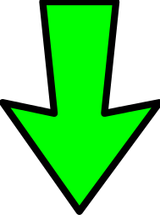
Protective Factors
Include but not limited to:
Family Support (e.g., visiting, correspondence) Active and motivated in psych treatment
Religious/spiritual/cultural beliefs Sense of optimism; self efficacy
Interpersonal social support Job or School Assignment
Future orientation/plans for future Insight into problems
Exercises regularly Spousal support
Children at home Positive coping skills and conflict resolution skills
Notes:
Protective factors are skills (e.g., coping strategies), strengths, or other factors exhibited by the individual that can be used to help reduce risk. However, some factors that are protective for one individual, may be risk factors for others.
Review of Chronic, Acute, and Protective factors is not an actuarial process. While it is true that suicide risk elevates as risk factors accumulate, the simple summation of the number of risk factors versus the number of protective factors should not be interpreted to mean that if an individual has more risk factors than protective factors, that the individual is at elevated or high risk. Instead, each assessment should determine whether the totality of the risk factors outweighs the totality of the protective factors. This requires individual-specific weighted judgment.
Can you think of any other Protective Factors?

Slide 17
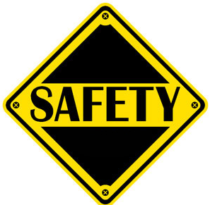
Safety Plan
A Safety Plan is a collaborative strategy developed by the individual and Psychology Staff member to identify those signs or symptoms that the individual may be decompensating and those specific steps the individual can take to be safe.
Safety plans are a critical piece of Suicide Risk Assessments that are completed by mental health professionals.
Main components of a Safety Plan:
a. identification of warning signs and symptoms of decompensation
b. coping skills that can be utilized to ensure personal safety
c. interventions that will be provided from correctional staff to ensure safety
Notes:
First, the patient and Psychology staff member should identify the warning signs and symptoms of potential safety concerns, which includes identifying those warning signs that the individual is beginning to struggle or the existing struggle is beginning to exacerbate even further. These warning signs and symptoms can include thoughts, feelings, behaviors, and or circumstances in which the risk for decompensation, suicide, suicidal ideation, violence, etc., is likely to recur.
Secondly, the patient and clinician should identify coping skills to ensure personal safety that the individual can utilize by themselves or with others to ensure their immediate safety. This process should include a discussion of coping skills utilized in the past to ameliorate similar stressors and new coping skills that the individual can discuss with the Psychology staff member for the purpose of deescalating one’s emotions, thoughts, or behaviors, either by themselves or with someone else. Additionally, this part of the plan should also include a discussion of the obstacles that might exist to implementing these coping skills and how to overcome these obstacles. This section of the plan should include the identification of emergency contacts (i.e., correctional and professional staff) for the individual and how to access and notify correctional staff of emergencies.
Finally, the Safety Plan should include a section related to the identification of the service strategies to be provided from the correctional and professional support system to ensure ongoing safety. This section should include the identification of what others could do to help ensure ongoing safety, if the individual’s crisis intensifies.
Safety plans should generally be based on data collected and the risk factors identified on an SRA. These plans should target acute risk factors and, if possible, reinforcement of protective factors. Safety plans should be generated collaboratively between the individual and the Psychology staff member. Safety plans should reflect a problem-solving approach.

Slide 18
Review of past 12 years of DOC Suicides = 111
History of Psych Treatment: 79 or 71%
Time between last MH contact and suicide: 79 occurred in less than 30 days or 71%
Object used for Suicide: Bedsheet – 78 or 70%
Inmate on MH Caseload: 75 or 68% Agitation at time of suicide: 18 or 16%
History of substance abuse: 71 or 64% SIB prior to Suicide: 17 or 15%
Inmate on Psychotropics: 61 or 55% Recent conflict with other inmate: 13 or 12%
History of SSA or SIB: 55 or 50%
Restricted Housing Unit: 42 or 38% Hopelessness at time of suicide: 13 or 12%
History of Trauma or abuse: 36 or 32% History of Family suicide: 9 or 8%
Psych Turmoil: 32 or 29% Recent decline in health: 6 or 5%
Other Stressors: 30 or 27%
Restricted Housing Unit: 27 Alienation: 8 or 7%
Recent change in Psych meds: 26 or 23% Psychotic symptoms: 6 or 5%
Depressive Symptoms: 25 or 23% Suicide plan identified: 5 or 5%
Recently received bad news: 19 or 17% Sudden Change in MSE: 4 or 4%
Notes:
This slides provides a high level overview of the presence of the most frequent risk factors identified among inmates who have died by suicide within the DOC during the past 12 years.
Several main takeaways from this slide: first, the risk factor of being alone (i.e., for any reason) was present in almost every suicide (96%) in the past 12 years.
Next, despite the high frequency of individuals being actively treated for MH issues (68%), this leaves a 1/3 of those individuals who have completed suicide as not actively receiving mental health treatment (i.e., A or B Roster). So, we can not simply only focus on those individuals who are on the active mental health rosters (C or D) as being at risk of suicide.
Finally, although historically, a majority of suicides have occurred in our RHU’s (i.e., closer to 70% all time), this review revealed that over the past 12 years only about 38% of suicides have occurred in RHUs, which suggests that staff need to be cognizant of suicide risk for inmates outside of RHUs and in general population housing units.

Slide 19
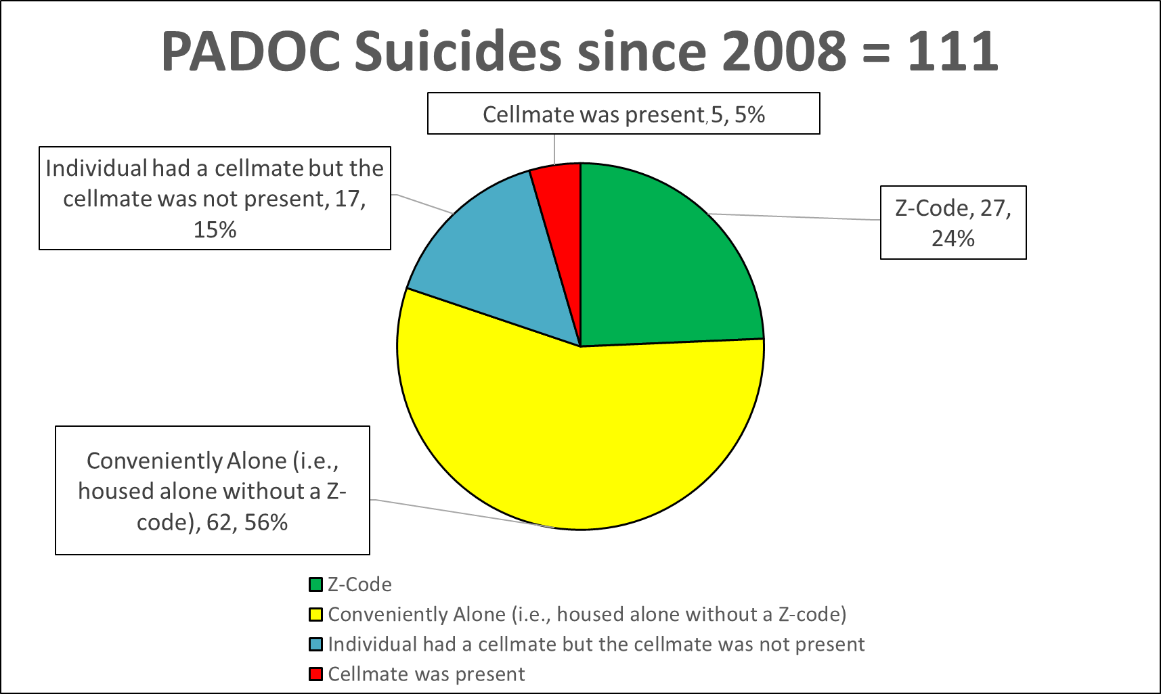
PA DOC Suicides since 2008
Notes:
A recent review of DOC suicides that occurred in the years of 2008 to 2019, revealed that we’ve had a total of 111 suicides during the most recent 12 year period.
The most concerning figure to is that of the 111 suicides, all but five inmates were in a cell alone at the time of their death.
27 Had a Z-code
62 were conveniently alone (i.e., housed alone without a Z-code)
17 had a cellmate, but the cellmate was not present at the time of death
5 were double celled and the cellmate was present at the time of death
Indeed, having a cell-mate and that cellmate being present are strong protective factors for suicide.

Slide 20
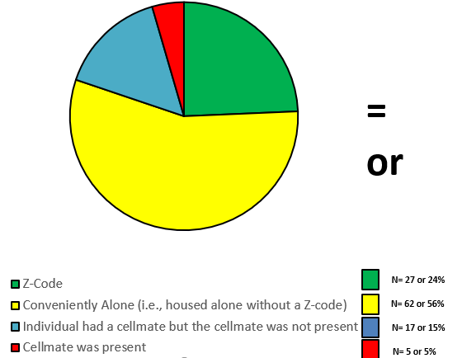
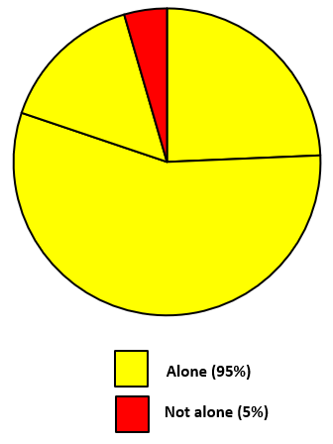
PA DOC Suicides and Being Alone
Notes:
This slide is presented to clearly illustrate just how powerful the influence of being “alone” is on suicides within our system during the previous 12 year period.

Slide 21

Emergent Mental Health Referral Procedures
The situation represents an EMERGENCY. It MUST be handled right here, right now.
Making statements about being hopeless, lonely, depressed
Showing direct suicide warning signs
Steps
Phone/Radio Call – inform about the situation
Follow direction from the Shift Commander/Unit Manage/
Chief Psychologist or Designee or ?
Notes:
Since any individual may report or demonstrate mental health issues whether or not they are currently receiving mental health treatment, all staff must be able to recognize signs of potential mental illness, suicidality, or elevated risk of violence, as well as delineate between. emergent and non-emergent referrals.
For emergent situations (i.e., those that require immediate attention), a phone call shall be made from the staff member witnessing the potential psychological emergency to the Psychology Department (or the Shift Commander, if after hours or if Psychology staff are not available) for the purposes of explaining the details of the situation and receiving direction on next steps, which may include escorting the individual to the infirmary (after hours) and/or remaining with the patient until Psychology is able to assess the individual.
An example of an appropriate emergent referral to Psychology staff would be in response to an inmate indicating to a correctional officer that she is tearful, reporting feeling very hopeless and feeling very depressed in response to learning that she has been given a “parole hit” of 2 years. In addition, she indicates that she is contemplating suicide and has indicated to you that she intends on killing herself by hanging herself from the vent in her cell with her bedsheet.
The idea behind an emergent referral is that it is the type of issue that presents an emergency which must be addressed right here, right now.
The other type of referral that staff may complete is a non-emergent referral.
EMERGENT referrals do NOT go DIRECTLY to PSYCHIATRY STAFF. This is NOT permitted. EMERGENT referrals are directed to Psychology staff or the shift commander, as above.

Slide 22
Non-Emergent Mental Health Referral Procedures
The situation does NOT represent an EMERGENCY.
Showing indirect suicide warning signs.
Steps
DC-97 – Mental Health Referral Form
Submit to the Psychology department at the SCI
Notes:
For non-emergent situations (i.e., those that do not require immediate attention by Psychology staff), the referring staff member shall document their observations or concerns on the DC-97 (i.e., Mental Health Referral Form) and submit it to the Psychology department at the SCI. Psychology staff will interview the individual as soon as possible after receipt of the referral, but no later than one week (i.e., five working days). If upon assessing the individual, Psychology believes that the individual should be seen by Psychiatry, as a non-emergent referral, Psychology staff would refer the individual to Psychiatry utilizing the DC-560 (i.e., Mental Health Progress Note).
Upon receiving the non-emergent referral, Psychiatry staff have 14 days to assess the individual. An example of an appropriate non-emergent referral to Psychology staff would be in response to an inmate asking a correctional officer to speak to Psychology staff because the inmate is feeling somewhat anxious about his parole hearing that is scheduled for next month and the inmate wishes to speak to Psychology staff about these anxious feelings.
The main take away with non-emergent referrals is that when a non-emergent referral is made, Psychology staff have up to 1 week to see the individual.

Slide 23
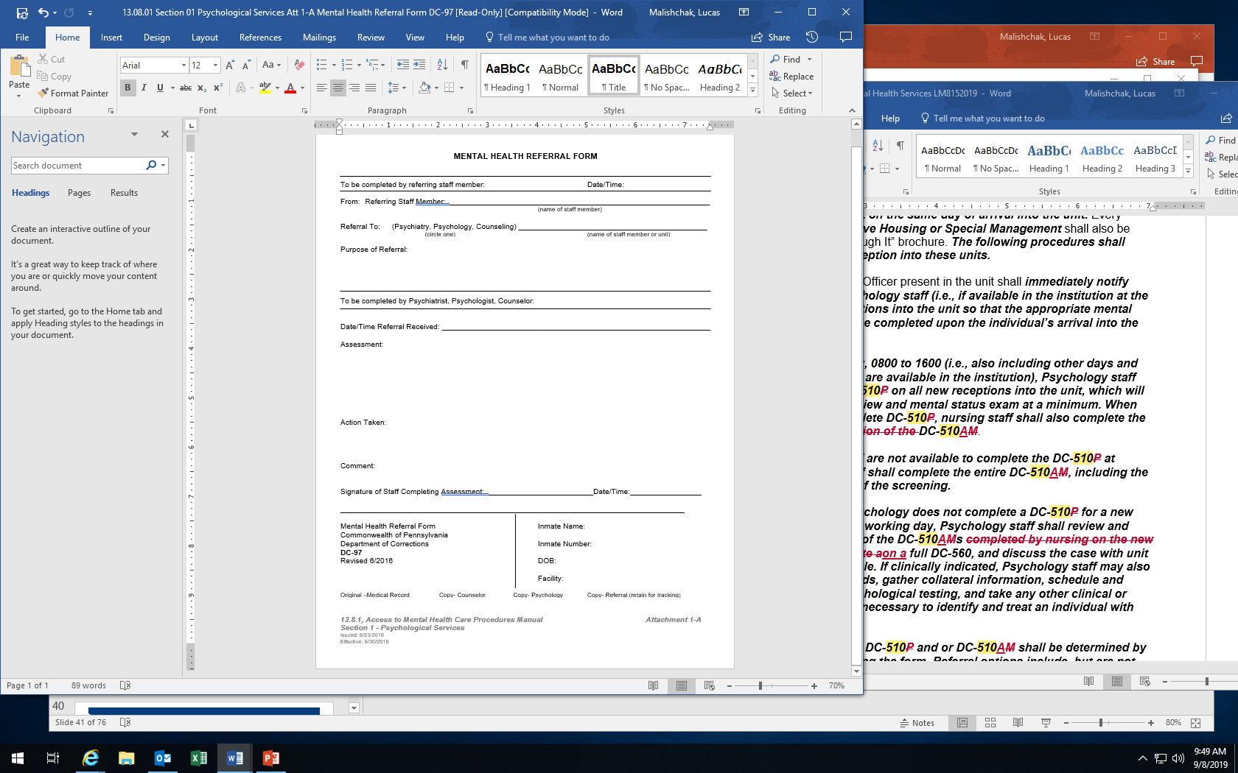
Non-Emergent Mental Health Referral-DC-97
Notes:
Above is an example of a DC-97 mental health referral.
REMEMBER, a DC-97 is ONLY appropriate for NON-EMERGENT referrals to mental health staff. The next slide will provide an overview of how to properly fill out a DC-97.

Slide 24
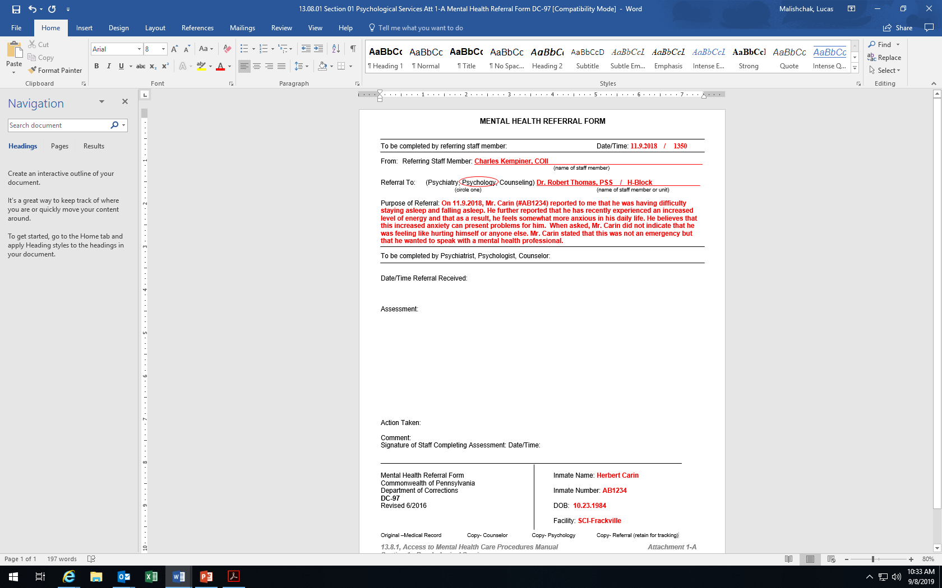
Non-Emergent Mental Health Referral-DC-97
Notes:
The areas completed in RED, are those areas to be completed by the REFERRING STAFF MEMBER. These areas include the DATE AND TIME that the REFERRING STAFF MEMBER is making the referral; the REFERRING STAFF MEMBER’S name; indication of which discipline the referring staff member desires to refer the individual to and THE NAME OF THE STAFF MEMBER the individual is to be referred to OR THE UNIT ON WHICH THE INDIVIDUAL LIVES; the PURPOSE OF THE REFERRAL and; at the bottom of the form, the REFERRING STAFF MEMBER is expected to fill out the INMATE NAME, INMATE NUMBER, DATE OF BIRTH, AND FACILITY.
Once the REFERRING STAFF MEMBER has filled out the DC-97, the REFERRING STAFF MEMBER is to submit the DC-97 to the INSTITUTION’S PSYCHOLOGY DEPARTMENT.

Slide 25
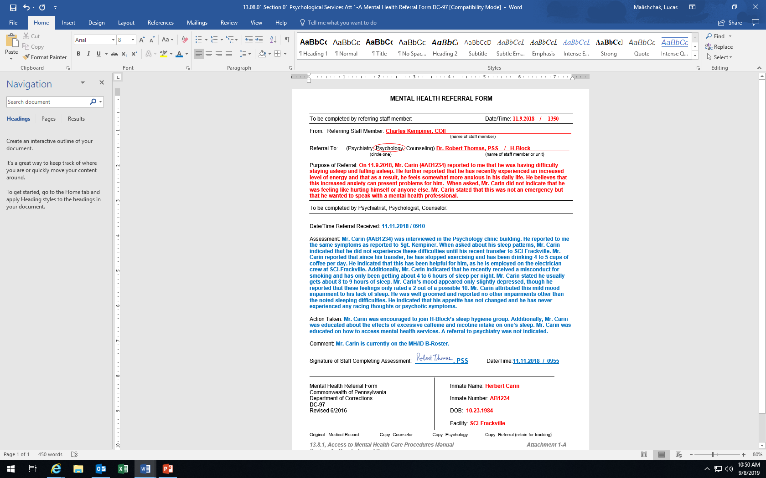
Non-Emergent Mental Health Referral-DC-97
Notes:
Once Psychology staff receive the Non-emergent, DC-97, mental health referral, a Psychology staff member will meet with the individual within 5 days of receiving the referral and the Psychology staff member will complete the referral process by filling out the rest of the form.
The areas completed in BLUE, are those areas to be completed by the STAFF MEMBER COMPLETING THE ASSESSMENT. Those areas include the DATE/TIME THE REFERRAL WAS RECEIVED; the ASSESSMENT; the ACTIONS TAKEN; the COMMENT (if needed); SIGNATURE OF STAFF COMPLETING ASSESSMENT and; DATE/TIME assessment was completed and signed off.
Let’s take a look at a few scenarios to ensure that you are able to distinguish between when to complete an emergent versus a non-emergent referral.

Slide 26
Emergent versus Non-Emergent Referral Scenarios
Each case requires a referral.
Determine which type of referral is indicated for each case and explain WHY you believe that type of referral is appropriate.
Case #1: Mr. Burns
Case #2: Ms. Hayes
Notes:
Case #1: While doing security rounds on first shift, you approach cell 1028 and observe inmate Burns alone in his cell. Mr. Burns’ cellmate is at work. Burns asks you if you have a minute to listen to a concern of his. Burns explains that he hasn’t had a chance to speak to his Psychologist in the past few days because he was out ATA at court and was in the county jail for a few days. Mr. Burns indicated that he typically sees his assigned Psychologist at least once per month. Burns indicated that while he was out to court, he received an additional 3-6 years for a robbery. He indicated that he expected more time, but was some what disappointed that he would be missing his son’s graduation from college next year. Mr. Burns appeared withdrawn and particularly unhappy with the situation and noted that he would be appealing the new conviction.
What type of Referral to Psychology do you believe is indicated? Emergent or Non-Emergent and Why?
Correct Answer: NON-EMERGENT. Mr. Burns’ issues do not require immediate attention. Although they appear legitimate, they do not present an EMERGENCY that must be addressed immediately. Mr. Burns has indicated that he is experiencing some mild symptoms of depression, but also indicated that he is regularly (i.e., at least once per month) seen by Psychology staff. However, you are aware that receiving additional time on top of one’s sentence is indeed “bad news” and can be particularly stressful for an individual that was anticipating going home within the next year. You identified that Mr. Burns did endorse at least some protective factors, including that he was looking towards the future (i.e., he would be appealing his case). Informing Mr. Burns that you will submit a NON-EMERGENT mental health referral to Psychology, via DC-97, will ensure that Psychology staff will see Mr. Burns within 1 week or five working days to address his concerns.
Case #2: On Thursday, you began your shift on H-Block at 1400. After an hour or so, Mr. Williams approaches your desk and states that he wants to speak to the Psychiatrist. When you ask Mr. Williams why he wants to speak to the Psychiatrist, he indicates that he needs his “meds increased.” Upon further inquiry, Mr. Williams states that its been more than 90 days since he last saw the doctor. Before you came onto shift, you checked the “pass down log” and you noticed that other correctional staff noted that Mr. Williams was “talking to himself” in his cell and that he also got into a confrontation in the dayroom with another inmate, which required staff’s intervention though no misconduct was issued. You ask Mr. Williams if he needs to see the Psychiatrist immediately. Mr. Williams stated its not an emergency but he wants to speak to the Psychiatrist. Your observations of Mr. Williams also included that he appeared somewhat unkempt and unclean, and clearly agitated.
What type of Referral do you believe is indicated? Emergent or Non-Emergent and Why? And who does your referral go to?
Correct Answer: NON-EMERGENT referral to PSYCHOLOGY. Mr. Williams has indicated that he desires to speak with Psychiatry. However, the issue that Mr. Williams is presenting to you (i.e., medications need to be reviewed) do not present an emergency. Mr. Williams indicated that his request is not an emergency but he does in fact, want to speak with Psychiatry. Your observations of the situation indicate that Mr. Williams does not require immediate attention, but he does require follow-up with a mental health professional, given that his hygiene appears somewhat poor, your observations included him to be somewhat agitated, the “pass-down log” revealed that he was recently confrontational with another inmate on first shift, as well as the potential observation of bizarre behaviors (i.e., seen talking to himself). Furthermore, correctional officers should not make direct referrals to PSYCHIATRY staff. Instead, inmates that request to speak with PSYCHIATRY must first be seen by PSYCHOLOGY. From here, PSYCHOLOGY staff determines whether the individual requires further referral to be assessed by PSYCHIATRY.
Case #3: During first shift on Friday, you commence security rounds of J-Block at 1007. J-Block is the Residential Treatment Unit which houses individuals with Serious Mental Illnesses. Upon approaching cell 1024, you see Ms. Hayes standing at her cell door. Ms. Hayes asks to speak to you briefly at the cell door. During her conversation, she reveals that she has lost hope of getting paroled because of the misconduct she received last week for “refusing to obey an order”. She indicates that she feels helpless and has been unusually reluctant to go to chow. Since you’ve worked on this block for the past few years, you’ve never noticed Ms. Hayes to act this way. You ask Ms. Hayes whether or not she is contemplating suicide. Ms. Hayes states that she would never kill herself because she “loves life and herself.” You ask Ms. Hayes if she is thinking about a plan of how to kill herself. Ms. Hayes reiterates that she would never kill herself but simply wanted to know when her cellmate would be returning from ATA (authorized temporary absence). Additionally, during your conversation with Ms. Hayes, you observe that she appears somewhat tearful though she seems to be holding back from completely crying. Her history is well known amongst the treatment team, in that she has attempted suicide in the pas following her removal from the Therapeutic Community. This attempt resulted in her placement into the Psychiatric Observation Cell and eventual commitment to the Mental Health Unit.
What type of Referral to Psychology do you believe is indicated? Emergent or Non-Emergent and Why?
Correct Answer: EMERGENT referral to PSYCHOLOGY. Although Ms. Hayes has indicated that she is not thinking about suicide or how she might kill herself, she has indeed reported hopelessness associated with her recent life changes. Additionally, given your tenure working on the block, you know that Ms. Hayes has been seeking parole for some time now and that this represented a significant loss and stressor to her. Furthermore, Ms. Hayes has reported several other significant changes in her eating patterns, as well as other feelings of hopelessness and observations of tearfulness and an unusual inquiry about when her cellmate would return from ATA (which possibly suggests Ms. Hayes’ desire to identify an opportunity to self-harm). In weighing whether or not to make an EMERGENT or NON-EMERGENT referral to Psychology staff, you decide that you are not comfortable with Ms. Hayes having to wait until potentially Monday morning to see a Psychology staff member, as you are also aware that she has a history of serious self-injury which resulted in POC and MHU placements. Taking all factors into full consideration, Ms. Hayes’ situation does appear to present an emergency that should be assessed immediately by Psychology staff. As a result, you inform Ms. Hayes of your desire to have her assessed by Psychology staff immediately. She indicates that she is thankful of this opportunity and would welcome a chance to speak to Psychology in a private and confidential setting. As a result, you call control and notify the shift commander immediately of the situation. Next, you radio down to the block bubble and inform Dr. Dan, the assigned block Psychologist, of the situation. Dr. Dan indicated that he is on his way down to cell 1024 to see Ms. Hayes. You remain with Ms. Hayes until Dr. Dan arrives.
Case #4: On Friday, you are working second shift (1400-2200) on B-block as a CO1. Prior to locking everyone in the for the evening, you observe Mr. Hudson exit the day room and walk towards your desk. He indicates that he just received notice that his mother was diagnosed with Cancer. He is devastated and obviously distraught. He looks at you and says “I’ve been here 20 years and have been the only support that my mother has. I can’t believe this has happened. I have nothing else to live for. My life is over. I am not going back to my cell. I do not feel safe being alone.” You ask Mr. Hudson if he is having thoughts of suicide. He immediately responds that he “wants to see his mother immediately.” Upon hearing this, you contemplate whether a referral to Psychology is indicated or whether to write a misconduct for “refusing to obey an order”. You remember that since it is second shift, Psychology staff has already left for the evening. As your concerns grow, you remember that Mr. Hudson was seen in the treatment team just last week. Given that you are a member of the treatment team and were in attendance, you remembered that the content of the discussion with the treatment team was that Mr. Hudson’s father also recently passed away and that given his life sentence, Mr. Hudson’s only supportive network outside of the prison included his mother.
What type of referral is indicated? EMERGENT or NON-EMERGENT and why? And who does your referral go to?
Correct Answer: EMERGENT referral to the Shift Commander. Given that Psychology staff are not available in the institution at this time, EMERGENT referrals are expected to be triaged and directed to the shift commander. Mr. Hudson appears to be experiencing a serious mental health crisis and a response to this crisis requires immediate action. Mr. Hudson is obviously extremely upset about learning of his mother’s prognosis. He has indicated that he does not feel safe being alone at this time and has expressed that he has nothing else to live for. You reflect about the seriousness of the situation given the other identified risk factors of being a “lifer”, experiencing other life stressors (e.g., father recently passing away), and having a diminishing social support network. Upon speaking to the shift commander, two officers are dispatched to B-Block to escort Mr. Hudson to the Psychiatric Observation Cell (POC) to be placed under constant watch, by orders of the Psychiatrist.

Slide 27
Emergent versus Non-Emergent Referral Scenarios
While doing chaplain rounds, you approach cell 1028 and observe inmate Burns alone in his cell. Mr. Burns’ cellmate is at work. Burns asks you if you have a minute to listen to a concern of his. Burns explains that he hasn’t had a chance to speak to the Chaplain in the past few days because he was out at court and was in the county jail for a week. Mr. Burns indicated that he typically sees his assigned Psychologist at least once per month. Burns indicated that while he was out to court, he received an additional 3-6 years for a robbery. He indicated that he expected more time, but was somewhat disappointed that he would be missing his son’s graduation from college next year. Mr. Burns appeared withdrawn and particularly unhappy with the situation and noted that he would be appealing the new conviction. You recognize Mr. Burns from his regular attendance at your service. You have a fairly good relationship with Mr. Burns, as he frequently is open to discussing his spirituality with you.
What type of Referral to Psychology do you believe is indicated? Emergent or Non-Emergent and Why?
Notes:
Case #1: While doing security rounds on first shift, you approach cell 1028 and observe inmate Burns alone in his cell. Mr. Burns’ cellmate is at work. Burns asks you if you have a minute to listen to a concern of his. Burns explains that he hasn’t had a chance to speak to his Psychologist in the past few days because he was out ATA at court and was in the county jail for a few days. Mr. Burns indicated that he typically sees his assigned Psychologist at least once per month. Burns indicated that while he was out to court, he received an additional 3-6 years for a robbery. He indicated that he expected more time, but was some what disappointed that he would be missing his son’s graduation from college next year. Mr. Burns appeared withdrawn and particularly unhappy with the situation and noted that he would be appealing the new conviction.
What type of Referral to Psychology do you believe is indicated? Emergent or Non-Emergent and Why?
Correct Answer: NON-EMERGENT. Mr. Burns’ issues do not require immediate attention. Although they appear legitimate, they do not present an EMERGENCY that must be addressed immediately. Mr. Burns has indicated that he is experiencing some mild symptoms of depression, but also indicated that he is regularly (i.e., at least once per month) seen by Psychology staff. However, you are aware that receiving additional time on top of one’s sentence is indeed “bad news” and can be particularly stressful for an individual that was anticipating going home within the next year. You identified that Mr. Burns did endorse at least some protective factors, including that he was looking towards the future (i.e., he would be appealing his case). Informing Mr. Burns that you will submit a NON-EMERGENT mental health referral to Psychology, via DC-97, will ensure that Psychology staff will see Mr. Burns within 1 week or five working days to address his concerns.
Case #2: On Thursday, you began your shift on H-Block at 1400. After an hour or so, Mr. Williams approaches your desk and states that he wants to speak to the Psychiatrist. When you ask Mr. Williams why he wants to speak to the Psychiatrist, he indicates that he needs his “meds increased.” Upon further inquiry, Mr. Williams states that its been more than 90 days since he last saw the doctor. Before you came onto shift, you checked the “pass down log” and you noticed that other correctional staff noted that Mr. Williams was “talking to himself” in his cell and that he also got into a confrontation in the dayroom with another inmate, which required staff’s intervention though no misconduct was issued. You ask Mr. Williams if he needs to see the Psychiatrist immediately. Mr. Williams stated its not an emergency but he wants to speak to the Psychiatrist. Your observations of Mr. Williams also included that he appeared somewhat unkempt and unclean, and clearly agitated.
What type of Referral do you believe is indicated? Emergent or Non-Emergent and Why? And who does your referral go to?
Correct Answer: NON-EMERGENT referral to PSYCHOLOGY. Mr. Williams has indicated that he desires to speak with Psychiatry. However, the issue that Mr. Williams is presenting to you (i.e., medications need to be reviewed) do not present an emergency. Mr. Williams indicated that his request is not an emergency but he does in fact, want to speak with Psychiatry. Your observations of the situation indicate that Mr. Williams does not require immediate attention, but he does require follow-up with a mental health professional, given that his hygiene appears somewhat poor, your observations included him to be somewhat agitated, the “pass-down log” revealed that he was recently confrontational with another inmate on first shift, as well as the potential observation of bizarre behaviors (i.e., seen talking to himself). Furthermore, correctional officers should not make direct referrals to PSYCHIATRY staff. Instead, inmates that request to speak with PSYCHIATRY must first be seen by PSYCHOLOGY. From here, PSYCHOLOGY staff determines whether the individual requires further referral to be assessed by PSYCHIATRY.
Case #3: During first shift on Friday, you commence security rounds of J-Block at 1007. J-Block is the Residential Treatment Unit which houses individuals with Serious Mental Illnesses. Upon approaching cell 1024, you see Ms. Hayes standing at her cell door. Ms. Hayes asks to speak to you briefly at the cell door. During her conversation, she reveals that she has lost hope of getting paroled because of the misconduct she received last week for “refusing to obey an order”. She indicates that she feels helpless and has been unusually reluctant to go to chow. Since you’ve worked on this block for the past few years, you’ve never noticed Ms. Hayes to act this way. You ask Ms. Hayes whether or not she is contemplating suicide. Ms. Hayes states that she would never kill herself because she “loves life and herself.” You ask Ms. Hayes if she is thinking about a plan of how to kill herself. Ms. Hayes reiterates that she would never kill herself but simply wanted to know when her cellmate would be returning from ATA (authorized temporary absence). Additionally, during your conversation with Ms. Hayes, you observe that she appears somewhat tearful though she seems to be holding back from completely crying. Her history is well known amongst the treatment team, in that she has attempted suicide in the pas following her removal from the Therapeutic Community. This attempt resulted in her placement into the Psychiatric Observation Cell and eventual commitment to the Mental Health Unit.
What type of Referral to Psychology do you believe is indicated? Emergent or Non-Emergent and Why?
Correct Answer: EMERGENT referral to PSYCHOLOGY. Although Ms. Hayes has indicated that she is not thinking about suicide or how she might kill herself, she has indeed reported hopelessness associated with her recent life changes. Additionally, given your tenure working on the block, you know that Ms. Hayes has been seeking parole for some time now and that this represented a significant loss and stressor to her. Furthermore, Ms. Hayes has reported several other significant changes in her eating patterns, as well as other feelings of hopelessness and observations of tearfulness and an unusual inquiry about when her cellmate would return from ATA (which possibly suggests Ms. Hayes’ desire to identify an opportunity to self-harm). In weighing whether or not to make an EMERGENT or NON-EMERGENT referral to Psychology staff, you decide that you are not comfortable with Ms. Hayes having to wait until potentially Monday morning to see a Psychology staff member, as you are also aware that she has a history of serious self-injury which resulted in POC and MHU placements. Taking all factors into full consideration, Ms. Hayes’ situation does appear to present an emergency that should be assessed immediately by Psychology staff. As a result, you inform Ms. Hayes of your desire to have her assessed by Psychology staff immediately. She indicates that she is thankful of this opportunity and would welcome a chance to speak to Psychology in a private and confidential setting. As a result, you call control and notify the shift commander immediately of the situation. Next, you radio down to the block bubble and inform Dr. Dan, the assigned block Psychologist, of the situation. Dr. Dan indicated that he is on his way down to cell 1024 to see Ms. Hayes. You remain with Ms. Hayes until Dr. Dan arrives.
Case #4: On Friday, you are working second shift (1400-2200) on B-block as a CO1. Prior to locking everyone in the for the evening, you observe Mr. Hudson exit the day room and walk towards your desk. He indicates that he just received notice that his mother was diagnosed with Cancer. He is devastated and obviously distraught. He looks at you and says “I’ve been here 20 years and have been the only support that my mother has. I can’t believe this has happened. I have nothing else to live for. My life is over. I am not going back to my cell. I do not feel safe being alone.” You ask Mr. Hudson if he is having thoughts of suicide. He immediately responds that he “wants to see his mother immediately.” Upon hearing this, you contemplate whether a referral to Psychology is indicated or whether to write a misconduct for “refusing to obey an order”. You remember that since it is second shift, Psychology staff has already left for the evening. As your concerns grow, you remember that Mr. Hudson was seen in the treatment team just last week. Given that you are a member of the treatment team and were in attendance, you remembered that the content of the discussion with the treatment team was that Mr. Hudson’s father also recently passed away and that given his life sentence, Mr. Hudson’s only supportive network outside of the prison included his mother.
What type of referral is indicated? EMERGENT or NON-EMERGENT and why? And who does your referral go to?
Correct Answer: EMERGENT referral to the Shift Commander. Given that Psychology staff are not available in the institution at this time, EMERGENT referrals are expected to be triaged and directed to the shift commander. Mr. Hudson appears to be experiencing a serious mental health crisis and a response to this crisis requires immediate action. Mr. Hudson is obviously extremely upset about learning of his mother’s prognosis. He has indicated that he does not feel safe being alone at this time and has expressed that he has nothing else to live for. You reflect about the seriousness of the situation given the other identified risk factors of being a “lifer”, experiencing other life stressors (e.g., father recently passing away), and having a diminishing social support network. Upon speaking to the shift commander, two officers are dispatched to B-Block to escort Mr. Hudson to the Psychiatric Observation Cell (POC) to be placed under constant watch, by orders of the Psychiatrist.

Slide 28
Emergent versus Non-Emergent Referral Scenarios
Correct Answer: NON-EMERGENT.
Mr. Burns’ issues do not require immediate attention. Although they appear legitimate, they do not present an EMERGENCY that must be addressed immediately. Mr. Burns has indicated that he is experiencing some mild symptoms of depression, but also indicated that he is regularly (i.e., at least once per month) seen by Psychology staff. However, you are aware that receiving additional time on top of one’s sentence is indeed “bad news” and can be particularly stressful for an individual that was anticipating going home within the next year. You identified that Mr. Burns did endorse at least some protective factors, including that he was looking towards the future (i.e., he would be appealing his case). Informing Mr. Burns that you will submit a NON-EMERGENT mental health referral to Psychology, via DC-97, will ensure that Psychology staff will see Mr. Burns within 1 week or five working days to address his concerns.
Notes:
Case #1: While doing security rounds on first shift, you approach cell 1028 and observe inmate Burns alone in his cell. Mr. Burns’ cellmate is at work. Burns asks you if you have a minute to listen to a concern of his. Burns explains that he hasn’t had a chance to speak to his Psychologist in the past few days because he was out ATA at court and was in the county jail for a few days. Mr. Burns indicated that he typically sees his assigned Psychologist at least once per month. Burns indicated that while he was out to court, he received an additional 3-6 years for a robbery. He indicated that he expected more time, but was some what disappointed that he would be missing his son’s graduation from college next year. Mr. Burns appeared withdrawn and particularly unhappy with the situation and noted that he would be appealing the new conviction.
What type of Referral to Psychology do you believe is indicated? Emergent or Non-Emergent and Why?
Correct Answer: NON-EMERGENT. Mr. Burns’ issues do not require immediate attention. Although they appear legitimate, they do not present an EMERGENCY that must be addressed immediately. Mr. Burns has indicated that he is experiencing some mild symptoms of depression, but also indicated that he is regularly (i.e., at least once per month) seen by Psychology staff. However, you are aware that receiving additional time on top of one’s sentence is indeed “bad news” and can be particularly stressful for an individual that was anticipating going home within the next year. You identified that Mr. Burns did endorse at least some protective factors, including that he was looking towards the future (i.e., he would be appealing his case). Informing Mr. Burns that you will submit a NON-EMERGENT mental health referral to Psychology, via DC-97, will ensure that Psychology staff will see Mr. Burns within 1 week or five working days to address his concerns.
Case #2: On Thursday, you began your shift on H-Block at 1400. After an hour or so, Mr. Williams approaches your desk and states that he wants to speak to the Psychiatrist. When you ask Mr. Williams why he wants to speak to the Psychiatrist, he indicates that he needs his “meds increased.” Upon further inquiry, Mr. Williams states that its been more than 90 days since he last saw the doctor. Before you came onto shift, you checked the “pass down log” and you noticed that other correctional staff noted that Mr. Williams was “talking to himself” in his cell and that he also got into a confrontation in the dayroom with another inmate, which required staff’s intervention though no misconduct was issued. You ask Mr. Williams if he needs to see the Psychiatrist immediately. Mr. Williams stated its not an emergency but he wants to speak to the Psychiatrist. Your observations of Mr. Williams also included that he appeared somewhat unkempt and unclean, and clearly agitated.
What type of Referral do you believe is indicated? Emergent or Non-Emergent and Why? And who does your referral go to?
Correct Answer: NON-EMERGENT referral to PSYCHOLOGY. Mr. Williams has indicated that he desires to speak with Psychiatry. However, the issue that Mr. Williams is presenting to you (i.e., medications need to be reviewed) do not present an emergency. Mr. Williams indicated that his request is not an emergency but he does in fact, want to speak with Psychiatry. Your observations of the situation indicate that Mr. Williams does not require immediate attention, but he does require follow-up with a mental health professional, given that his hygiene appears somewhat poor, your observations included him to be somewhat agitated, the “pass-down log” revealed that he was recently confrontational with another inmate on first shift, as well as the potential observation of bizarre behaviors (i.e., seen talking to himself). Furthermore, correctional officers should not make direct referrals to PSYCHIATRY staff. Instead, inmates that request to speak with PSYCHIATRY must first be seen by PSYCHOLOGY. From here, PSYCHOLOGY staff determines whether the individual requires further referral to be assessed by PSYCHIATRY.
Case #3: During first shift on Friday, you commence security rounds of J-Block at 1007. J-Block is the Residential Treatment Unit which houses individuals with Serious Mental Illnesses. Upon approaching cell 1024, you see Ms. Hayes standing at her cell door. Ms. Hayes asks to speak to you briefly at the cell door. During her conversation, she reveals that she has lost hope of getting paroled because of the misconduct she received last week for “refusing to obey an order”. She indicates that she feels helpless and has been unusually reluctant to go to chow. Since you’ve worked on this block for the past few years, you’ve never noticed Ms. Hayes to act this way. You ask Ms. Hayes whether or not she is contemplating suicide. Ms. Hayes states that she would never kill herself because she “loves life and herself.” You ask Ms. Hayes if she is thinking about a plan of how to kill herself. Ms. Hayes reiterates that she would never kill herself but simply wanted to know when her cellmate would be returning from ATA (authorized temporary absence). Additionally, during your conversation with Ms. Hayes, you observe that she appears somewhat tearful though she seems to be holding back from completely crying. Her history is well known amongst the treatment team, in that she has attempted suicide in the pas following her removal from the Therapeutic Community. This attempt resulted in her placement into the Psychiatric Observation Cell and eventual commitment to the Mental Health Unit.
What type of Referral to Psychology do you believe is indicated? Emergent or Non-Emergent and Why?
Correct Answer: EMERGENT referral to PSYCHOLOGY. Although Ms. Hayes has indicated that she is not thinking about suicide or how she might kill herself, she has indeed reported hopelessness associated with her recent life changes. Additionally, given your tenure working on the block, you know that Ms. Hayes has been seeking parole for some time now and that this represented a significant loss and stressor to her. Furthermore, Ms. Hayes has reported several other significant changes in her eating patterns, as well as other feelings of hopelessness and observations of tearfulness and an unusual inquiry about when her cellmate would return from ATA (which possibly suggests Ms. Hayes’ desire to identify an opportunity to self-harm). In weighing whether or not to make an EMERGENT or NON-EMERGENT referral to Psychology staff, you decide that you are not comfortable with Ms. Hayes having to wait until potentially Monday morning to see a Psychology staff member, as you are also aware that she has a history of serious self-injury which resulted in POC and MHU placements. Taking all factors into full consideration, Ms. Hayes’ situation does appear to present an emergency that should be assessed immediately by Psychology staff. As a result, you inform Ms. Hayes of your desire to have her assessed by Psychology staff immediately. She indicates that she is thankful of this opportunity and would welcome a chance to speak to Psychology in a private and confidential setting. As a result, you call control and notify the shift commander immediately of the situation. Next, you radio down to the block bubble and inform Dr. Dan, the assigned block Psychologist, of the situation. Dr. Dan indicated that he is on his way down to cell 1024 to see Ms. Hayes. You remain with Ms. Hayes until Dr. Dan arrives.
Case #4: On Friday, you are working second shift (1400-2200) on B-block as a CO1. Prior to locking everyone in the for the evening, you observe Mr. Hudson exit the day room and walk towards your desk. He indicates that he just received notice that his mother was diagnosed with Cancer. He is devastated and obviously distraught. He looks at you and says “I’ve been here 20 years and have been the only support that my mother has. I can’t believe this has happened. I have nothing else to live for. My life is over. I am not going back to my cell. I do not feel safe being alone.” You ask Mr. Hudson if he is having thoughts of suicide. He immediately responds that he “wants to see his mother immediately.” Upon hearing this, you contemplate whether a referral to Psychology is indicated or whether to write a misconduct for “refusing to obey an order”. You remember that since it is second shift, Psychology staff has already left for the evening. As your concerns grow, you remember that Mr. Hudson was seen in the treatment team just last week. Given that you are a member of the treatment team and were in attendance, you remembered that the content of the discussion with the treatment team was that Mr. Hudson’s father also recently passed away and that given his life sentence, Mr. Hudson’s only supportive network outside of the prison included his mother.
What type of referral is indicated? EMERGENT or NON-EMERGENT and why? And who does your referral go to?
Correct Answer: EMERGENT referral to the Shift Commander. Given that Psychology staff are not available in the institution at this time, EMERGENT referrals are expected to be triaged and directed to the shift commander. Mr. Hudson appears to be experiencing a serious mental health crisis and a response to this crisis requires immediate action. Mr. Hudson is obviously extremely upset about learning of his mother’s prognosis. He has indicated that he does not feel safe being alone at this time and has expressed that he has nothing else to live for. You reflect about the seriousness of the situation given the other identified risk factors of being a “lifer”, experiencing other life stressors (e.g., father recently passing away), and having a diminishing social support network. Upon speaking to the shift commander, two officers are dispatched to B-Block to escort Mr. Hudson to the Psychiatric Observation Cell (POC) to be placed under constant watch, by orders of the Psychiatrist.

Slide 29
Emergent versus Non-Emergent Referral Scenarios
On Friday, you entered the Restricted Housing Unit to conduct Chaplain rounds. Upon approaching cell 1024, you see Ms. Hayes standing at her cell door. Ms. Hayes asks to speak to you briefly at the cell door. During her conversation, she reveals that she has lost hope of getting paroled because of the misconduct she received last week for “refusing to obey an order”. She indicates that she feels helpless and has been unusually reluctant to go to chow. Since you’ve worked in this prison for the past few years, you’ve never noticed Ms. Hayes to act this way, especially when she has attended your service. You ask Ms. Hayes whether or not she is contemplating suicide. Ms. Hayes states that she would never kill herself because she “loves life and herself.” You ask Ms. Hayes if she is thinking about a plan of how to kill herself. Ms. Hayes reiterates that she would never kill herself but simply wanted to know when her cellmate would be returning from ATA (authorized temporary absence). Additionally, during your conversation with Ms. Hayes, you observe that she appears somewhat tearful though she seems to be holding back from completely crying. You know Ms. Hayes to have a strong conviction to her faith, and is extremely resilient in having dealt with many life and spiritual stressors during her incarceration. Ms. Hayes’ history is well known to you and other Chaplains in the prison, in that she has attempted suicide in the past following other stressful life events. These other self-injuries resulted in Psychiatric Observation and Mental Health Unit placements.
Notes:
Case #1: While doing security rounds on first shift, you approach cell 1028 and observe inmate Burns alone in his cell. Mr. Burns’ cellmate is at work. Burns asks you if you have a minute to listen to a concern of his. Burns explains that he hasn’t had a chance to speak to his Psychologist in the past few days because he was out ATA at court and was in the county jail for a few days. Mr. Burns indicated that he typically sees his assigned Psychologist at least once per month. Burns indicated that while he was out to court, he received an additional 3-6 years for a robbery. He indicated that he expected more time, but was some what disappointed that he would be missing his son’s graduation from college next year. Mr. Burns appeared withdrawn and particularly unhappy with the situation and noted that he would be appealing the new conviction.
What type of Referral to Psychology do you believe is indicated? Emergent or Non-Emergent and Why?
Correct Answer: NON-EMERGENT. Mr. Burns’ issues do not require immediate attention. Although they appear legitimate, they do not present an EMERGENCY that must be addressed immediately. Mr. Burns has indicated that he is experiencing some mild symptoms of depression, but also indicated that he is regularly (i.e., at least once per month) seen by Psychology staff. However, you are aware that receiving additional time on top of one’s sentence is indeed “bad news” and can be particularly stressful for an individual that was anticipating going home within the next year. You identified that Mr. Burns did endorse at least some protective factors, including that he was looking towards the future (i.e., he would be appealing his case). Informing Mr. Burns that you will submit a NON-EMERGENT mental health referral to Psychology, via DC-97, will ensure that Psychology staff will see Mr. Burns within 1 week or five working days to address his concerns.
Case #2: On Thursday, you began your shift on H-Block at 1400. After an hour or so, Mr. Williams approaches your desk and states that he wants to speak to the Psychiatrist. When you ask Mr. Williams why he wants to speak to the Psychiatrist, he indicates that he needs his “meds increased.” Upon further inquiry, Mr. Williams states that its been more than 90 days since he last saw the doctor. Before you came onto shift, you checked the “pass down log” and you noticed that other correctional staff noted that Mr. Williams was “talking to himself” in his cell and that he also got into a confrontation in the dayroom with another inmate, which required staff’s intervention though no misconduct was issued. You ask Mr. Williams if he needs to see the Psychiatrist immediately. Mr. Williams stated its not an emergency but he wants to speak to the Psychiatrist. Your observations of Mr. Williams also included that he appeared somewhat unkempt and unclean, and clearly agitated.
What type of Referral do you believe is indicated? Emergent or Non-Emergent and Why? And who does your referral go to?
Correct Answer: NON-EMERGENT referral to PSYCHOLOGY. Mr. Williams has indicated that he desires to speak with Psychiatry. However, the issue that Mr. Williams is presenting to you (i.e., medications need to be reviewed) do not present an emergency. Mr. Williams indicated that his request is not an emergency but he does in fact, want to speak with Psychiatry. Your observations of the situation indicate that Mr. Williams does not require immediate attention, but he does require follow-up with a mental health professional, given that his hygiene appears somewhat poor, your observations included him to be somewhat agitated, the “pass-down log” revealed that he was recently confrontational with another inmate on first shift, as well as the potential observation of bizarre behaviors (i.e., seen talking to himself). Furthermore, correctional officers should not make direct referrals to PSYCHIATRY staff. Instead, inmates that request to speak with PSYCHIATRY must first be seen by PSYCHOLOGY. From here, PSYCHOLOGY staff determines whether the individual requires further referral to be assessed by PSYCHIATRY.
Case #3: During first shift on Friday, you commence security rounds of J-Block at 1007. J-Block is the Residential Treatment Unit which houses individuals with Serious Mental Illnesses. Upon approaching cell 1024, you see Ms. Hayes standing at her cell door. Ms. Hayes asks to speak to you briefly at the cell door. During her conversation, she reveals that she has lost hope of getting paroled because of the misconduct she received last week for “refusing to obey an order”. She indicates that she feels helpless and has been unusually reluctant to go to chow. Since you’ve worked on this block for the past few years, you’ve never noticed Ms. Hayes to act this way. You ask Ms. Hayes whether or not she is contemplating suicide. Ms. Hayes states that she would never kill herself because she “loves life and herself.” You ask Ms. Hayes if she is thinking about a plan of how to kill herself. Ms. Hayes reiterates that she would never kill herself but simply wanted to know when her cellmate would be returning from ATA (authorized temporary absence). Additionally, during your conversation with Ms. Hayes, you observe that she appears somewhat tearful though she seems to be holding back from completely crying. Her history is well known amongst the treatment team, in that she has attempted suicide in the pas following her removal from the Therapeutic Community. This attempt resulted in her placement into the Psychiatric Observation Cell and eventual commitment to the Mental Health Unit.
What type of Referral to Psychology do you believe is indicated? Emergent or Non-Emergent and Why?
Correct Answer: EMERGENT referral to PSYCHOLOGY. Although Ms. Hayes has indicated that she is not thinking about suicide or how she might kill herself, she has indeed reported hopelessness associated with her recent life changes. Additionally, given your tenure working on the block, you know that Ms. Hayes has been seeking parole for some time now and that this represented a significant loss and stressor to her. Furthermore, Ms. Hayes has reported several other significant changes in her eating patterns, as well as other feelings of hopelessness and observations of tearfulness and an unusual inquiry about when her cellmate would return from ATA (which possibly suggests Ms. Hayes’ desire to identify an opportunity to self-harm). In weighing whether or not to make an EMERGENT or NON-EMERGENT referral to Psychology staff, you decide that you are not comfortable with Ms. Hayes having to wait until potentially Monday morning to see a Psychology staff member, as you are also aware that she has a history of serious self-injury which resulted in POC and MHU placements. Taking all factors into full consideration, Ms. Hayes’ situation does appear to present an emergency that should be assessed immediately by Psychology staff. As a result, you inform Ms. Hayes of your desire to have her assessed by Psychology staff immediately. She indicates that she is thankful of this opportunity and would welcome a chance to speak to Psychology in a private and confidential setting. As a result, you call control and notify the shift commander immediately of the situation. Next, you radio down to the block bubble and inform Dr. Dan, the assigned block Psychologist, of the situation. Dr. Dan indicated that he is on his way down to cell 1024 to see Ms. Hayes. You remain with Ms. Hayes until Dr. Dan arrives.
Case #4: On Friday, you are working second shift (1400-2200) on B-block as a CO1. Prior to locking everyone in the for the evening, you observe Mr. Hudson exit the day room and walk towards your desk. He indicates that he just received notice that his mother was diagnosed with Cancer. He is devastated and obviously distraught. He looks at you and says “I’ve been here 20 years and have been the only support that my mother has. I can’t believe this has happened. I have nothing else to live for. My life is over. I am not going back to my cell. I do not feel safe being alone.” You ask Mr. Hudson if he is having thoughts of suicide. He immediately responds that he “wants to see his mother immediately.” Upon hearing this, you contemplate whether a referral to Psychology is indicated or whether to write a misconduct for “refusing to obey an order”. You remember that since it is second shift, Psychology staff has already left for the evening. As your concerns grow, you remember that Mr. Hudson was seen in the treatment team just last week. Given that you are a member of the treatment team and were in attendance, you remembered that the content of the discussion with the treatment team was that Mr. Hudson’s father also recently passed away and that given his life sentence, Mr. Hudson’s only supportive network outside of the prison included his mother.
What type of referral is indicated? EMERGENT or NON-EMERGENT and why? And who does your referral go to?
Correct Answer: EMERGENT referral to the Shift Commander. Given that Psychology staff are not available in the institution at this time, EMERGENT referrals are expected to be triaged and directed to the shift commander. Mr. Hudson appears to be experiencing a serious mental health crisis and a response to this crisis requires immediate action. Mr. Hudson is obviously extremely upset about learning of his mother’s prognosis. He has indicated that he does not feel safe being alone at this time and has expressed that he has nothing else to live for. You reflect about the seriousness of the situation given the other identified risk factors of being a “lifer”, experiencing other life stressors (e.g., father recently passing away), and having a diminishing social support network. Upon speaking to the shift commander, two officers are dispatched to B-Block to escort Mr. Hudson to the Psychiatric Observation Cell (POC) to be placed under constant watch, by orders of the Psychiatrist.

Slide 30
Emergent versus Non-Emergent Referral Scenarios
Correct Answer: EMERGENT referral to PSYCHOLOGY.
Although Ms. Hayes has indicated that she is not thinking about suicide or how she might kill herself, she has indeed reported hopelessness associated with her recent life changes. Additionally, given your tenure as a Chaplain in the prison, you know that Ms. Hayes has been seeking parole for some time now and that this represented a significant loss and stressor to her. Furthermore, Ms. Hayes has reported several other significant changes in her eating patterns, as well as other feelings of hopelessness and observations of tearfulness and an unusual inquiry about when her cellmate would return from ATA (which possibly suggests Ms. Hayes’ desire to identify an opportunity to self-harm). In weighing whether or not to make an EMERGENT or NON-EMERGENT referral to Psychology staff, you decide that you are not comfortable with Ms. Hayes having to wait until potentially Monday morning to see a Psychology staff member, as you are also aware that she has a history of serious self-injury which resulted in POC and MHU placements. Taking all factors into full consideration, Ms. Hayes’ situation does appear to present an emergency that should be assessed immediately by Psychology staff. As a result, you inform Ms. Hayes of your desire to have her assessed by Psychology staff immediately. She indicates that she is thankful of this opportunity and would welcome a chance to speak to Psychology in a private and confidential setting. As a result, you remain at Ms. Hayes’ cell and notify the rounding block officer immediately of the situation. Next, the correctional officer notifies Dr. Dan, the assigned block Psychologist, of the situation. Dr. Dan indicated that he is on his way down to cell 1024 to see Ms. Hayes. You remain with Ms. Hayes until Dr. Dan arrives.
Notes:
Case #1: While doing security rounds on first shift, you approach cell 1028 and observe inmate Burns alone in his cell. Mr. Burns’ cellmate is at work. Burns asks you if you have a minute to listen to a concern of his. Burns explains that he hasn’t had a chance to speak to his Psychologist in the past few days because he was out ATA at court and was in the county jail for a few days. Mr. Burns indicated that he typically sees his assigned Psychologist at least once per month. Burns indicated that while he was out to court, he received an additional 3-6 years for a robbery. He indicated that he expected more time, but was some what disappointed that he would be missing his son’s graduation from college next year. Mr. Burns appeared withdrawn and particularly unhappy with the situation and noted that he would be appealing the new conviction.
What type of Referral to Psychology do you believe is indicated? Emergent or Non-Emergent and Why?
Correct Answer: NON-EMERGENT. Mr. Burns’ issues do not require immediate attention. Although they appear legitimate, they do not present an EMERGENCY that must be addressed immediately. Mr. Burns has indicated that he is experiencing some mild symptoms of depression, but also indicated that he is regularly (i.e., at least once per month) seen by Psychology staff. However, you are aware that receiving additional time on top of one’s sentence is indeed “bad news” and can be particularly stressful for an individual that was anticipating going home within the next year. You identified that Mr. Burns did endorse at least some protective factors, including that he was looking towards the future (i.e., he would be appealing his case). Informing Mr. Burns that you will submit a NON-EMERGENT mental health referral to Psychology, via DC-97, will ensure that Psychology staff will see Mr. Burns within 1 week or five working days to address his concerns.
Case #2: On Thursday, you began your shift on H-Block at 1400. After an hour or so, Mr. Williams approaches your desk and states that he wants to speak to the Psychiatrist. When you ask Mr. Williams why he wants to speak to the Psychiatrist, he indicates that he needs his “meds increased.” Upon further inquiry, Mr. Williams states that its been more than 90 days since he last saw the doctor. Before you came onto shift, you checked the “pass down log” and you noticed that other correctional staff noted that Mr. Williams was “talking to himself” in his cell and that he also got into a confrontation in the dayroom with another inmate, which required staff’s intervention though no misconduct was issued. You ask Mr. Williams if he needs to see the Psychiatrist immediately. Mr. Williams stated its not an emergency but he wants to speak to the Psychiatrist. Your observations of Mr. Williams also included that he appeared somewhat unkempt and unclean, and clearly agitated.
What type of Referral do you believe is indicated? Emergent or Non-Emergent and Why? And who does your referral go to?
Correct Answer: NON-EMERGENT referral to PSYCHOLOGY. Mr. Williams has indicated that he desires to speak with Psychiatry. However, the issue that Mr. Williams is presenting to you (i.e., medications need to be reviewed) do not present an emergency. Mr. Williams indicated that his request is not an emergency but he does in fact, want to speak with Psychiatry. Your observations of the situation indicate that Mr. Williams does not require immediate attention, but he does require follow-up with a mental health professional, given that his hygiene appears somewhat poor, your observations included him to be somewhat agitated, the “pass-down log” revealed that he was recently confrontational with another inmate on first shift, as well as the potential observation of bizarre behaviors (i.e., seen talking to himself). Furthermore, correctional officers should not make direct referrals to PSYCHIATRY staff. Instead, inmates that request to speak with PSYCHIATRY must first be seen by PSYCHOLOGY. From here, PSYCHOLOGY staff determines whether the individual requires further referral to be assessed by PSYCHIATRY.
Case #3: During first shift on Friday, you commence security rounds of J-Block at 1007. J-Block is the Residential Treatment Unit which houses individuals with Serious Mental Illnesses. Upon approaching cell 1024, you see Ms. Hayes standing at her cell door. Ms. Hayes asks to speak to you briefly at the cell door. During her conversation, she reveals that she has lost hope of getting paroled because of the misconduct she received last week for “refusing to obey an order”. She indicates that she feels helpless and has been unusually reluctant to go to chow. Since you’ve worked on this block for the past few years, you’ve never noticed Ms. Hayes to act this way. You ask Ms. Hayes whether or not she is contemplating suicide. Ms. Hayes states that she would never kill herself because she “loves life and herself.” You ask Ms. Hayes if she is thinking about a plan of how to kill herself. Ms. Hayes reiterates that she would never kill herself but simply wanted to know when her cellmate would be returning from ATA (authorized temporary absence). Additionally, during your conversation with Ms. Hayes, you observe that she appears somewhat tearful though she seems to be holding back from completely crying. Her history is well known amongst the treatment team, in that she has attempted suicide in the pas following her removal from the Therapeutic Community. This attempt resulted in her placement into the Psychiatric Observation Cell and eventual commitment to the Mental Health Unit.
What type of Referral to Psychology do you believe is indicated? Emergent or Non-Emergent and Why?
Correct Answer: EMERGENT referral to PSYCHOLOGY. Although Ms. Hayes has indicated that she is not thinking about suicide or how she might kill herself, she has indeed reported hopelessness associated with her recent life changes. Additionally, given your tenure working on the block, you know that Ms. Hayes has been seeking parole for some time now and that this represented a significant loss and stressor to her. Furthermore, Ms. Hayes has reported several other significant changes in her eating patterns, as well as other feelings of hopelessness and observations of tearfulness and an unusual inquiry about when her cellmate would return from ATA (which possibly suggests Ms. Hayes’ desire to identify an opportunity to self-harm). In weighing whether or not to make an EMERGENT or NON-EMERGENT referral to Psychology staff, you decide that you are not comfortable with Ms. Hayes having to wait until potentially Monday morning to see a Psychology staff member, as you are also aware that she has a history of serious self-injury which resulted in POC and MHU placements. Taking all factors into full consideration, Ms. Hayes’ situation does appear to present an emergency that should be assessed immediately by Psychology staff. As a result, you inform Ms. Hayes of your desire to have her assessed by Psychology staff immediately. She indicates that she is thankful of this opportunity and would welcome a chance to speak to Psychology in a private and confidential setting. As a result, you call control and notify the shift commander immediately of the situation. Next, you radio down to the block bubble and inform Dr. Dan, the assigned block Psychologist, of the situation. Dr. Dan indicated that he is on his way down to cell 1024 to see Ms. Hayes. You remain with Ms. Hayes until Dr. Dan arrives.
Case #4: On Friday, you are working second shift (1400-2200) on B-block as a CO1. Prior to locking everyone in the for the evening, you observe Mr. Hudson exit the day room and walk towards your desk. He indicates that he just received notice that his mother was diagnosed with Cancer. He is devastated and obviously distraught. He looks at you and says “I’ve been here 20 years and have been the only support that my mother has. I can’t believe this has happened. I have nothing else to live for. My life is over. I am not going back to my cell. I do not feel safe being alone.” You ask Mr. Hudson if he is having thoughts of suicide. He immediately responds that he “wants to see his mother immediately.” Upon hearing this, you contemplate whether a referral to Psychology is indicated or whether to write a misconduct for “refusing to obey an order”. You remember that since it is second shift, Psychology staff has already left for the evening. As your concerns grow, you remember that Mr. Hudson was seen in the treatment team just last week. Given that you are a member of the treatment team and were in attendance, you remembered that the content of the discussion with the treatment team was that Mr. Hudson’s father also recently passed away and that given his life sentence, Mr. Hudson’s only supportive network outside of the prison included his mother.
What type of referral is indicated? EMERGENT or NON-EMERGENT and why? And who does your referral go to?
Correct Answer: EMERGENT referral to the Shift Commander. Given that Psychology staff are not available in the institution at this time, EMERGENT referrals are expected to be triaged and directed to the shift commander. Mr. Hudson appears to be experiencing a serious mental health crisis and a response to this crisis requires immediate action. Mr. Hudson is obviously extremely upset about learning of his mother’s prognosis. He has indicated that he does not feel safe being alone at this time and has expressed that he has nothing else to live for. You reflect about the seriousness of the situation given the other identified risk factors of being a “lifer”, experiencing other life stressors (e.g., father recently passing away), and having a diminishing social support network. Upon speaking to the shift commander, two officers are dispatched to B-Block to escort Mr. Hudson to the Psychiatric Observation Cell (POC) to be placed under constant watch, by orders of the Psychiatrist.

Slide 31
Mental Health Referral Procedure REMINDERS
Depending on how “emergent” the situation is will dictate the staff member’s action.
A DC-97 is NOT appropriate for every situation. Remember, for those instances deemed to be EMERGENCIES, an EMERGENT response is required. A DC-97 is NOT appropriate for an emergency.
The Psychiatric provider initiates suicide precautions as per program policy.

Slide 32
Mental Health Referral Procedure REMINDERS
For emergent referrals, do not leave the individual alone until a mental health professional is able to see the patient. Once Psychology is notified of an emergent referral, Psychology staff are to IMMEDIATELY see the person.
A non-emergent referral may be made to psychology for further evaluation and treatment. If Psychology determines that it is necessary, Psychology staff will refer the person to Psychiatry.

Slide 33
Concluding Remarks
Attitude, communication, and collaboration mean everything.
False Deniers
Consider Risks. Consider Protective Factors. Ask about their Safety Plan
ALONE
Emergent vs. Non-Emergent Referrals

Slide 34
Questions
Dr. Lucas D. Malishchak, DBA
Director of the Psychology Office
Pennsylvania Department of Corrections
LMalishcha@pa.gov
717-728-2093

